Slide 1
3 Helices
Curve generated as trajectory of a helical movement of point M in space is a helix. Helical movement is a specific motion composed from two simple motions. One is rotation about given axis, while the other one might be:
– translation in direction of a vector, cylindrical helical movement
– scaling to a fixed point by a coefficient, conical helical movement
– rotation about second axis perpendicular to the first axis of rotation, spherical helical movement.
By one of the helical movements of point M the respective helix is generated.
All above helices are curves with specific intrinsic geometric properties, winded on elementary surfaces:
– cylindrical helix on cylindrical surface of revolution
– conical helix on conical surface of revolution
– spherical helix on sphere.

Slide 2
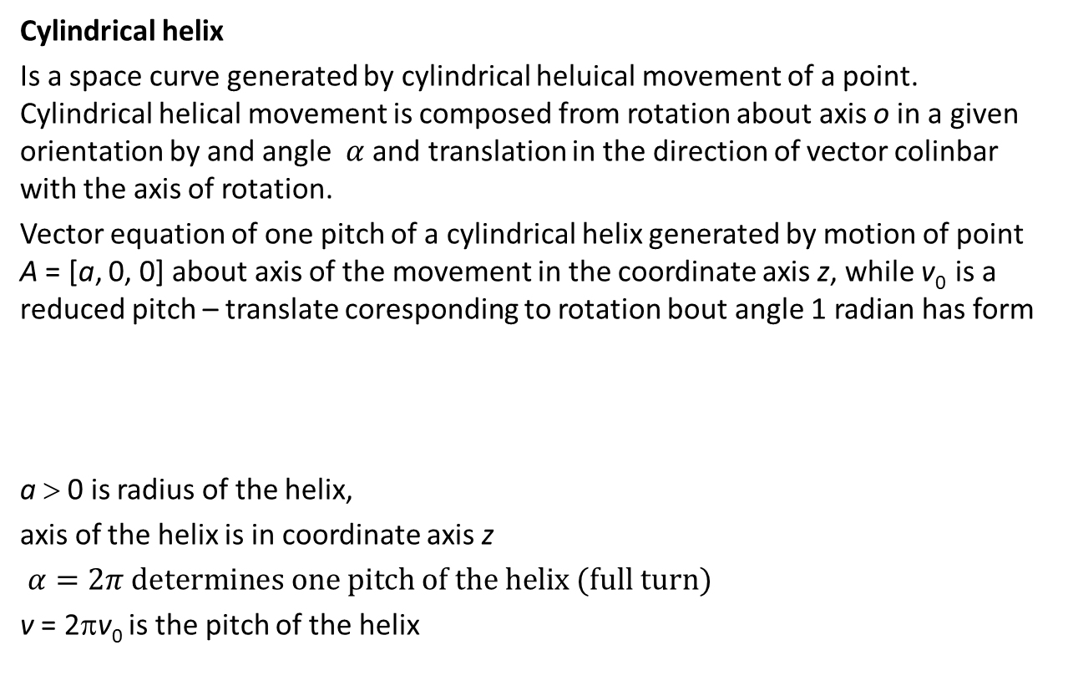
Cylindrical helix
Is a space curve generated by cylindrical heluical movement of a point. Cylindrical helical movement is composed from rotation about axis o in a given orientation by and angle $α$ and translation in the direction of vector colinbar with the axis of rotation.
Vector equation of one pitch of a cylindrical helix generated by motion of point A = [a, 0, 0] about axis of the movement in the coordinate axis z, while v₀ is a reduced pitch – translate coresponding to rotation bout angle 1 radian has form
a > 0 is radius of the helix,
axis of the helix is in coordinate axis z
$α=2π determines one pitch of the helix (full turn)$
v = 2πv₀ is the pitch of the helix
$r\left(u\right) =\left(a\cos{αu}, a\sin{αu}, αv_{0}u\right)$, $u∈\left\langle 0, 1\right\rangle ,α∈\left\langle 0, 2π\right\rangle$

Slide 3
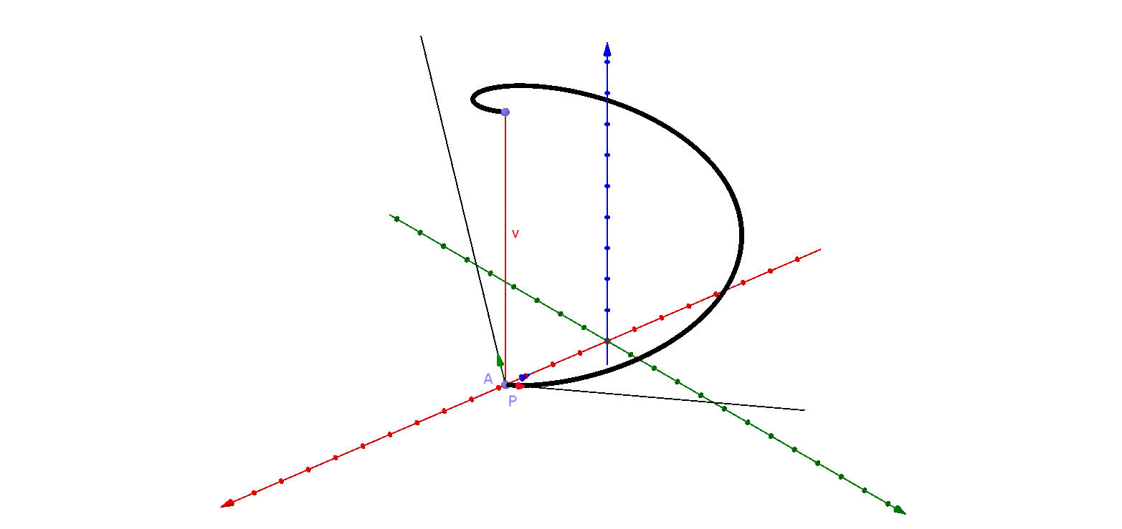
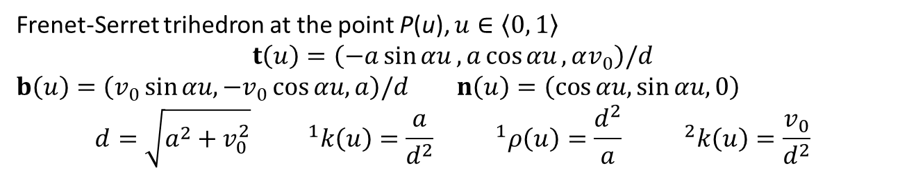
Frenet-Serret trihedron at the point P(u), $u∈\left\langle 0, 1\right\rangle$
$$t\left(u\right)=\left(−a\sin{αu}, a\cos{αu}, αv_{0}\right)/d$$
$b\left(u\right)=\left(v_{0}\sin{αu, −v_{0}\cos{αu, a}}\right)/d$ $n\left(u\right)=\left(\cos{αu,\sin{αu, 0}}\right)$
$$d=\sqrt{a^{2}+v_{0}^{2}}{ }^{1}k\left(u\right)=\frac{a}{d^{2}}{ }^{1}ρ\left(u\right)=\frac{d^{2}}{a}{ }^{2}k\left(u\right)=\frac{v_{0}}{d^{2}}$$
Cylindrical helix is a curve of constant non-zero first and second curvature.

Slide 4
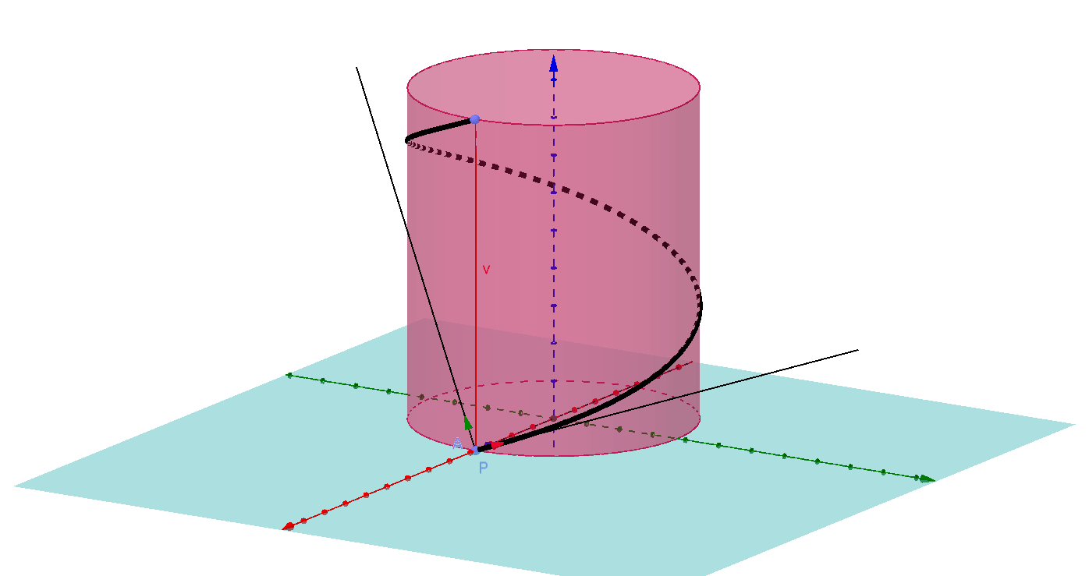
Cylindrical helix is a curve winded on a rotational cylindrical surface with axis in the axis of the helical movement o and basic circle that is the circle of rotation of point A about axis o with the radius a (radius of the helix).

Slide 5
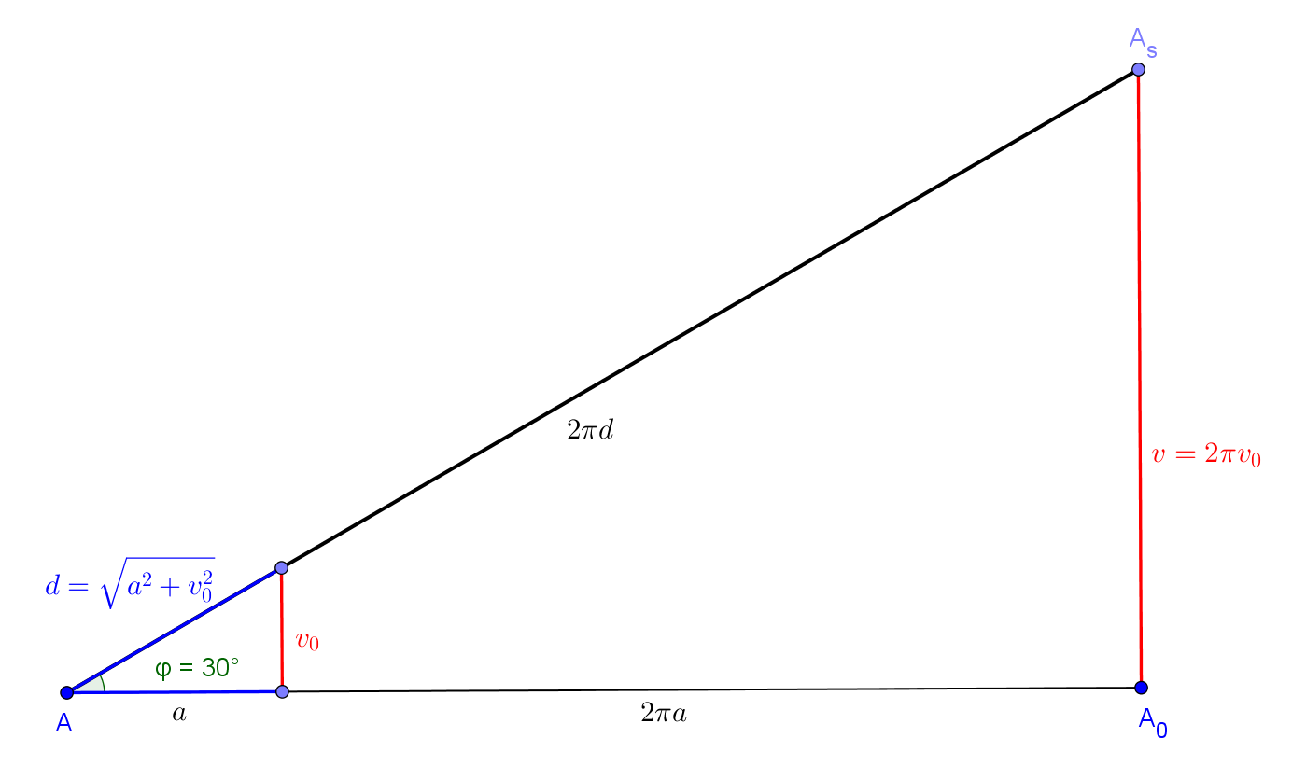

One pitch of cylindrical helix might be developed to the hypotenuse of a right-angled triangle with legs of size v (pitch of the helix) and 2πa (circumference of the basic circle of rotational cylindrical surface, on which the helix is winded).
$$\left|AA^{s}\right|=\sqrt{4π^{2}a^{2}+v^{2}}=2π\sqrt{a^{2}+v_{0}^{2}}=2πd$$
Angle ϕ, formed by all tangent lines to cylindrical helix with the plane perpendicular to axis of the helical movement is constant. Cylindrical helix is a curve of constant slope determined as $tg φ=\frac{v}{2πa}=\frac{v_{0}}{a}$ .

Slide 6
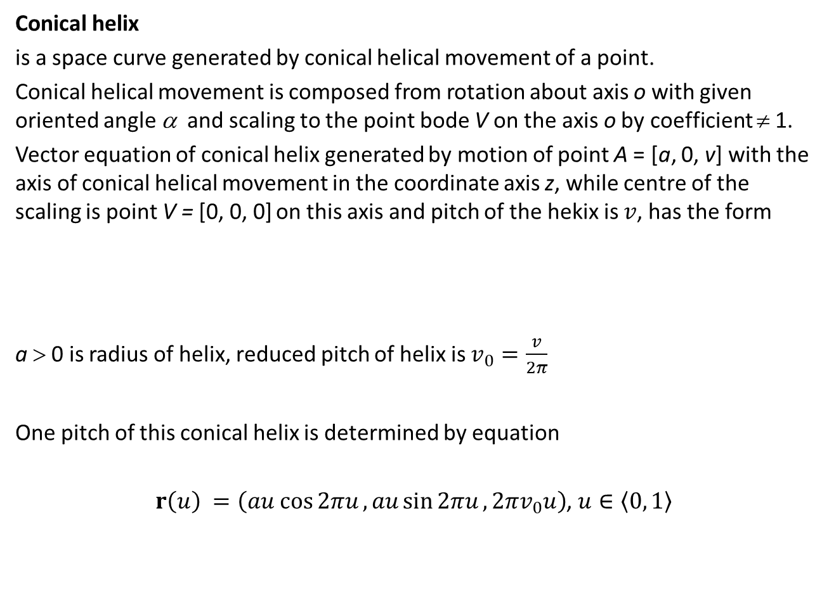
Conical helix
is a space curve generated by conical helical movement of a point.
Conical helical movement is composed from rotation about axis o with given oriented angle α and scaling to the point bode V on the axis o by coefficient ≠ 1.
Vector equation of conical helix generated by motion of point A = [a, 0, v] with the axis of conical helical movement in the coordinate axis z, while centre of the scaling is point V = [0, 0, 0] on this axis and pitch of the hekix is $v$, has the form
a > 0 is radius of helix, reduced pitch of helix is $v_{0}=\frac{v}{2π}$
One pitch of this conical helix is determined by equation
$r\left(u\right) =\left(au cos{2πu}, au\sin{2πu},{2πv}_{0}u\right)$, $u∈\left\langle 0, 1\right\rangle$
$r\left(u\right) =\left(au cos{αu}, au\sin{αu},α\frac{v}{2π}u\right)$, $u∈\left\langle 0, 1\right\rangle ,α∈\left\langle 0, 2π\right\rangle$

Slide 7
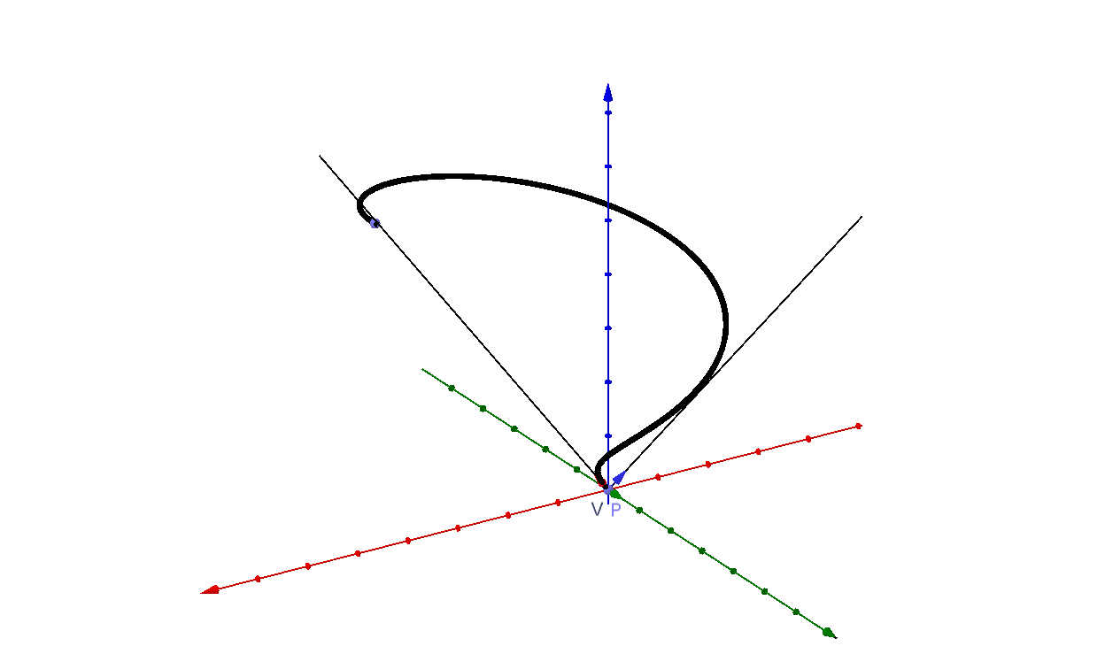
Frenet-Serret trihedron at the point $P\left(u\right),$ $u∈\left\langle 0, 1\right\rangle$

Slide 8
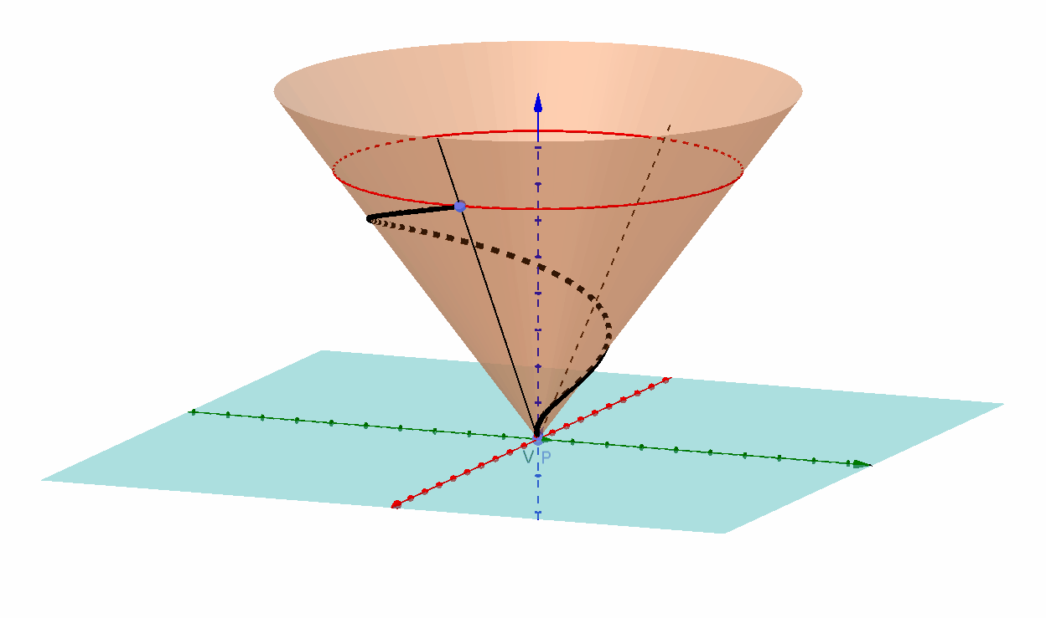
Conical helix is winded on conical rotational surface with axis in the axis of the conical helical movement o, vertex on this axis wich is the centre of the scaling V and one circle on the surface that is circle of rotation of point A about axis o with radius a.

Slide 9
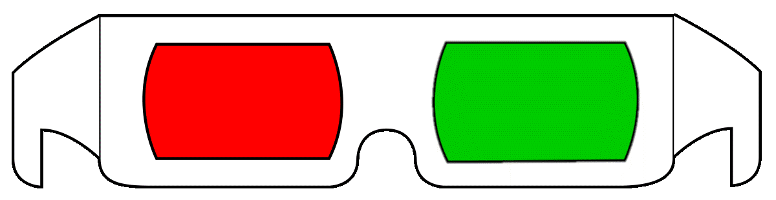
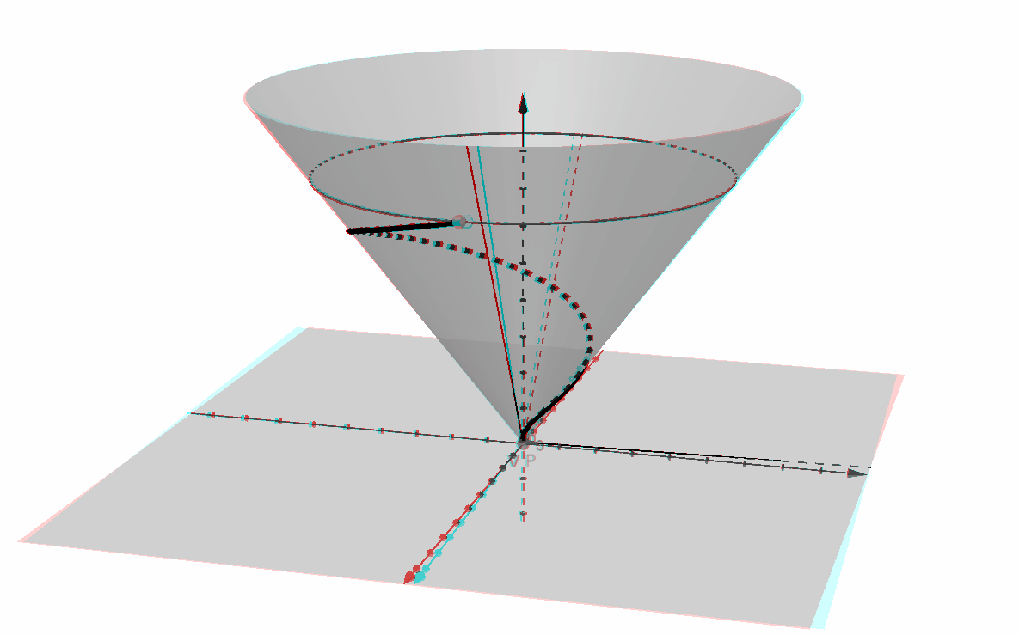
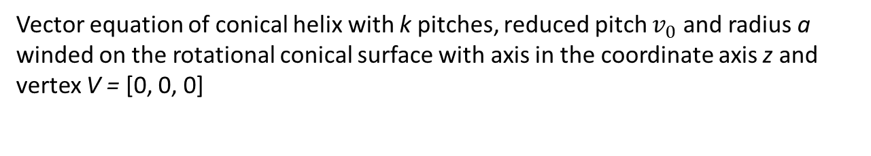
Vector equation of conical helix with k pitches, reduced pitch $v_{0}$ and radius a winded on the rotational conical surface with axis in the coordinate axis z and vertex V = [0, 0, 0]
$r\left(u\right) =\left(au cos{αku}, au\sin{αku},αkv_{0}u\right)$, $u∈\left\langle 0, 1\right\rangle ,α∈\left\langle 0, 2π\right\rangle$

Slide 10
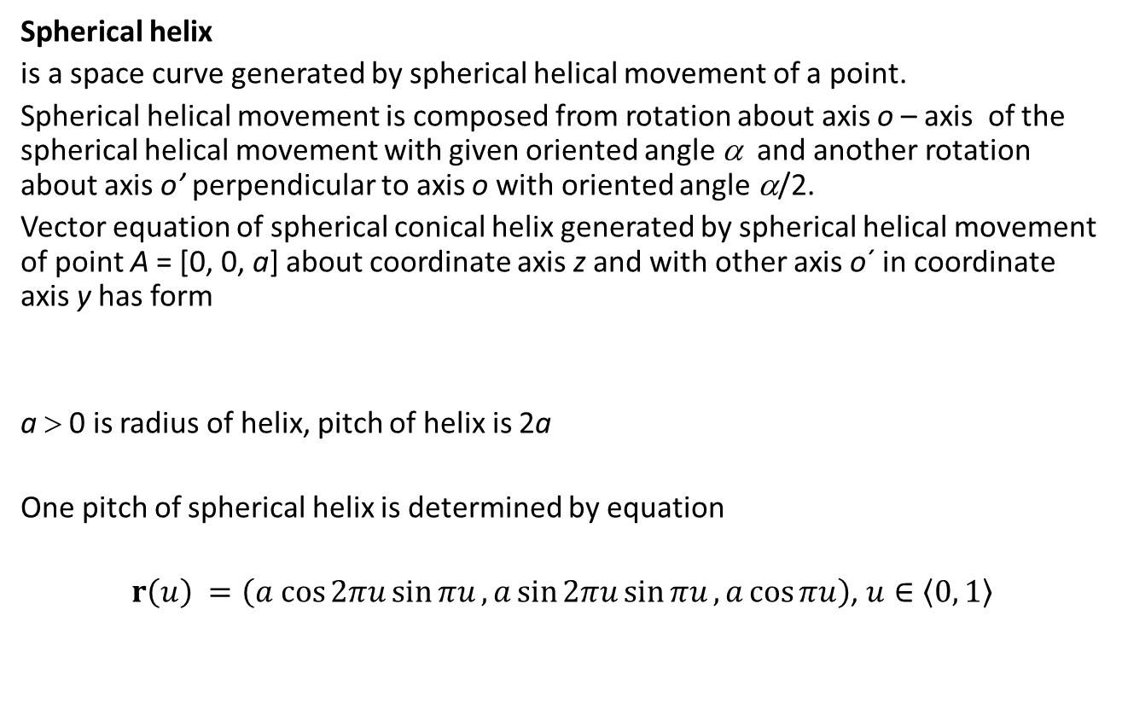
Spherical helix
is a space curve generated by spherical helical movement of a point.
Spherical helical movement is composed from rotation about axis o – axis of the spherical helical movement with given oriented angle α and another rotation about axis o’ perpendicular to axis o with oriented angle α/2.
Vector equation of spherical conical helix generated by spherical helical movement of point A = [0, 0, a] about coordinate axis z and with other axis o´ in coordinate axis y has form
a > 0 is radius of helix, pitch of helix is 2a
One pitch of spherical helix is determined by equation
$r\left(u\right) =\left(a cos{2πu}\sin{πu}, a\sin{2πu}\sin{πu},a\cos{πu}\right)$, $u∈\left\langle 0, 1\right\rangle$
$r\left(u\right) =\left(a cos{αu}\sin{αu/2}, a\sin{αu\sin{αu/2}}, a\cos{αu/2}\right)$, $u∈\left\langle 0, 1\right\rangle ,α∈\left\langle 0, 2π\right\rangle$

Slide 11
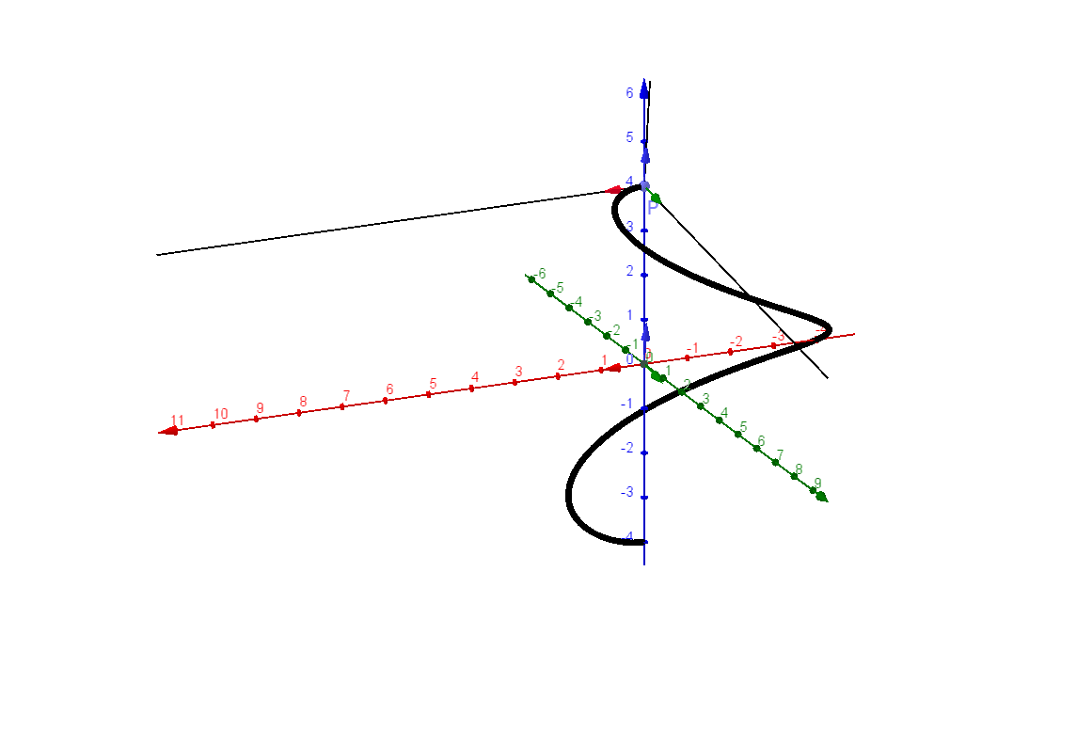
Frenet-Serret trihedron at point $P\left(u\right)$, $u∈\left\langle 0, 1\right\rangle$

Slide 12
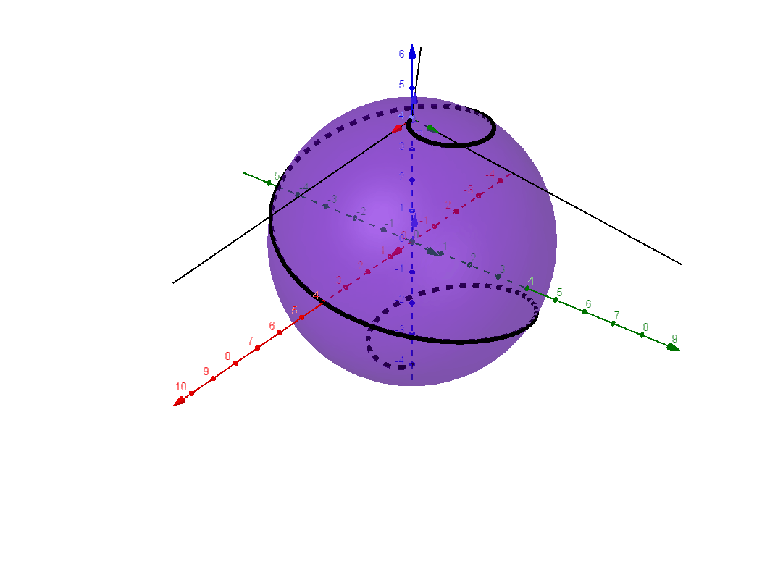
Spherical helix is a curve winded on sphere with centre in the intersection point of the two axes of rotation and with radius equal to the radius a of helix.

Slide 13
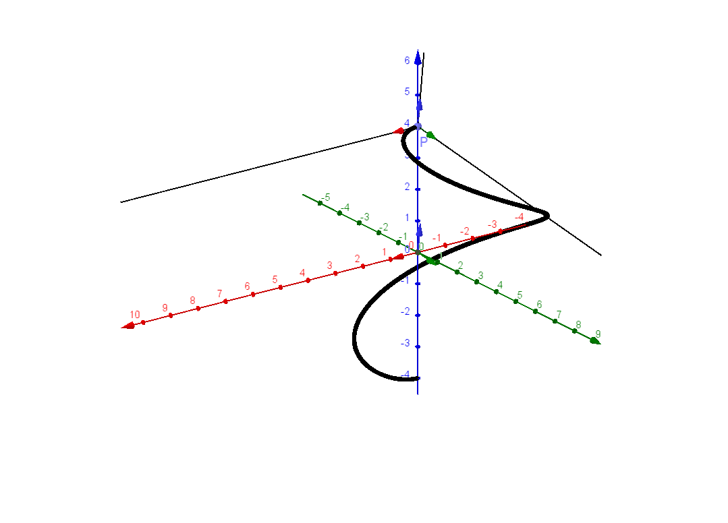
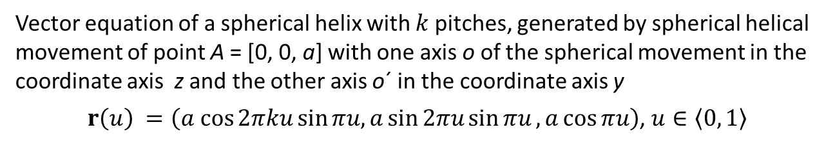
Vector equation of a spherical helix with $k$pitches, generated by spherical helical movement of point A = [0, 0, a] with one axis o of the spherical movement in the coordinate axis z and the other axis o´ in the coordinate axis y
$r\left(u\right) =\left(a cos{2πku}\sin{πu,}a\sin{2πu}\sin{πu},a\cos{πu}\right)$, $u∈\left\langle 0, 1\right\rangle$

Slide 14
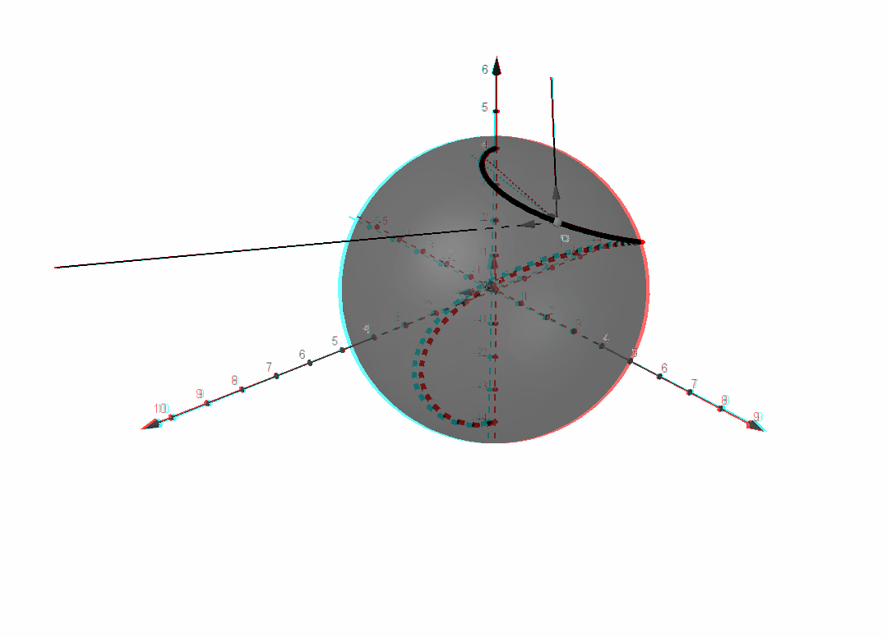
S$pherical helix with k pitches winded on a sphere$ with centre at origin and radius a.

