Slide 1
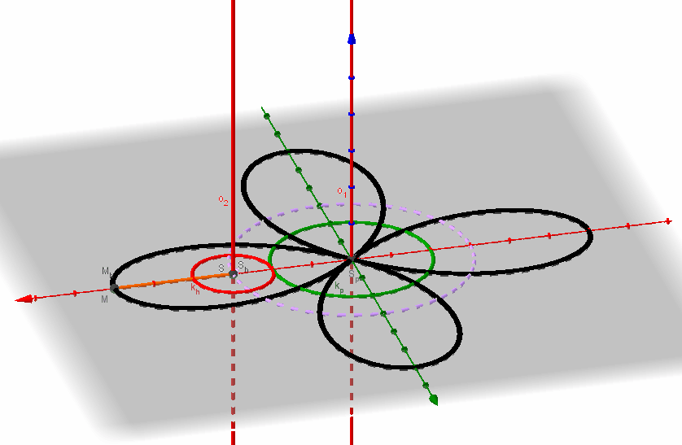
5.2 Cycloidal curves
Curve that is trajectory of a point M jointed to a moving circle k_{h}(S_{h}, r_{h}) that is rolling over a fixed circle k_{p}(S_{p}, r_{p}) (or line) is a cycloidal curve - cycloid. One branch of a cycloid is generated by one roll-off of circle k_{h} over fixed circle (or line) k_{p}, while circumference of the rolling circle k_{h} is winded on the fixed circle k_{p}. Thus the cycloidal movement is composed from two rotations about parallel axes passing through centres of the circles perpendicularly to the plane, in which both are located.

Slide 2
By different combinations of superposition of circles k_{h} and k_{p} , (or circle and line, which is regarded as circle with infinitely large radius), the following types of cycloids are obtained:
Epicycloid – moving circle k_{h} is rolling by its outer circumference on the outer circumference of fixed circle k_{p}.
Hypocycloid – moving circle k_{h} is rolling by its outer circumference on the inner circumference of fixed circle k_{p} (r_{h} < r_{p}).
Pericycloid – moving circle k_{h} is rolling by its inner circumference on the outer circumference of fixed circle k_{p} (r_{h} > r_{p}).
Pericycloidal movement is reversible to the epicycloidal movement,
therefore trajectories of these movements are the same curves.
4. Orthocycloid – moving circle k_{h} is rolling on the fixed line k_{p}.
Length of one branch of orthocycloid equals to the circumference of the moving circle.
5. Involute of a circle – moving line k_{h} is rolling on a fixed circle k_{p}.

Slide 3
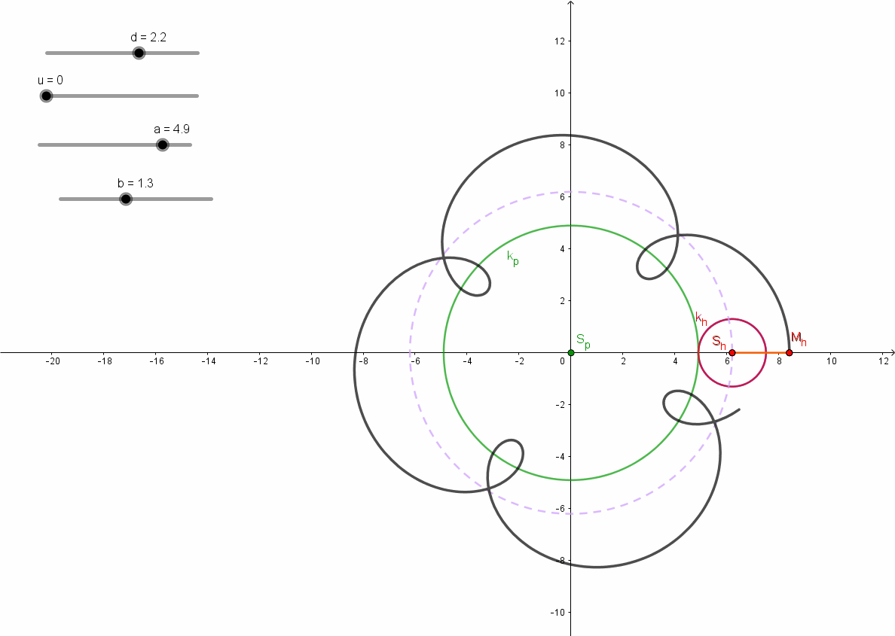
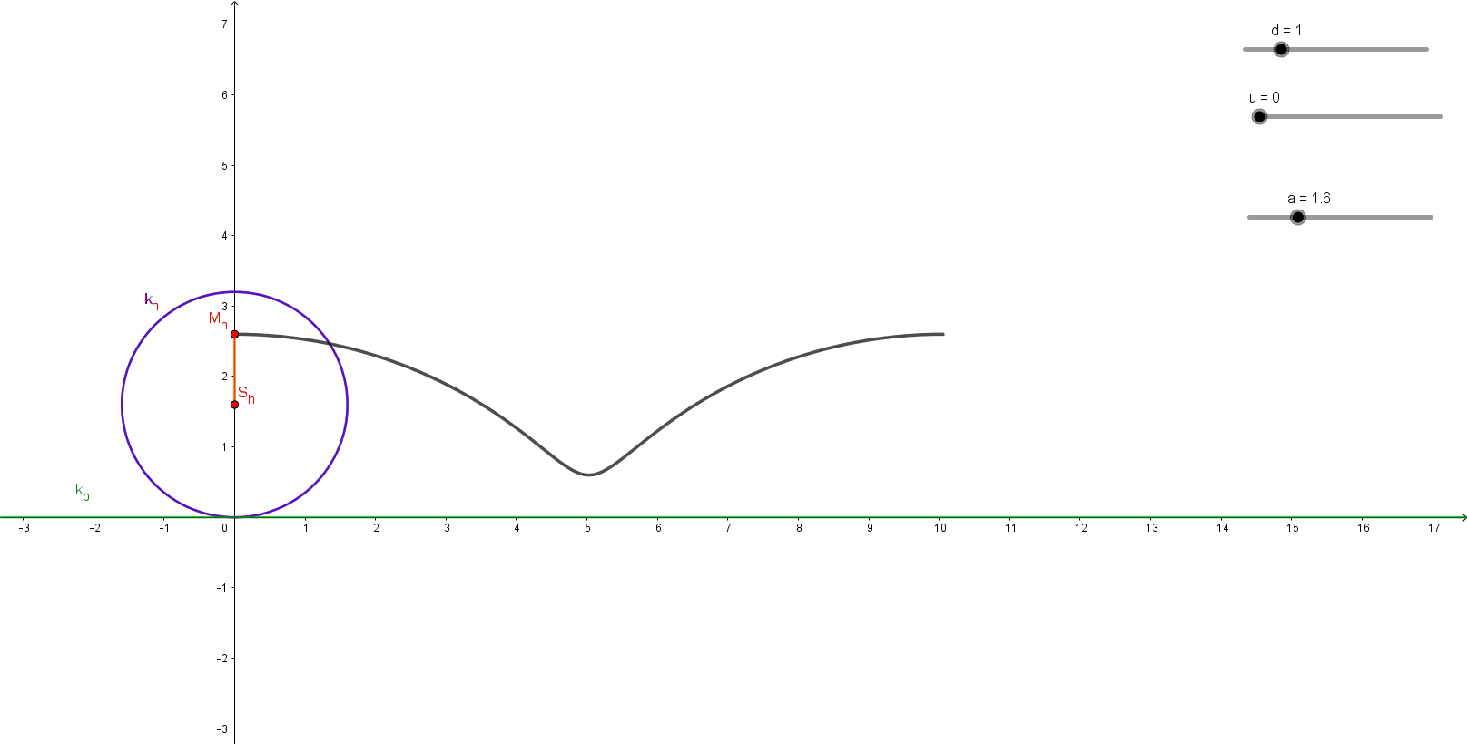
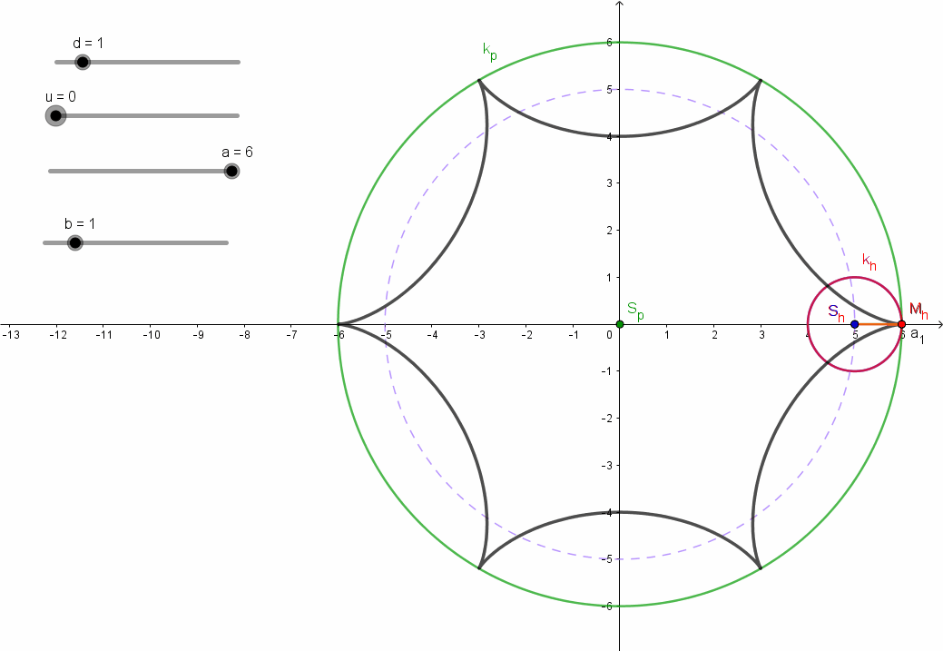
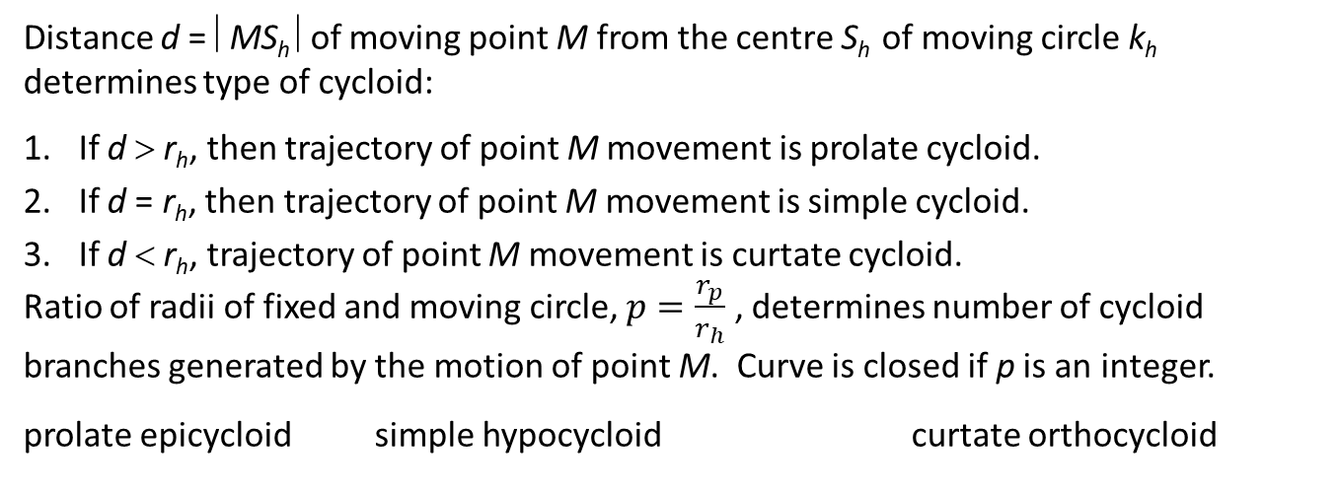
Distance d = ⎜MS_{h} ⎜of moving point M from the centre S_{h} of moving circle k_{h} determines type of cycloid:
If d > r_{h}, then trajectory of point M movement is prolate cycloid.
If d = r_{h}, then trajectory of point M movement is simple cycloid.
If d < r_{h}, trajectory of point M movement is curtate cycloid.
Ratio of radii of fixed and moving circle, $p=\frac{r_{p}}{r_{h}}$ , determines number of cycloid branches generated by the motion of point M. Curve is closed if p is an integer.
prolate epicycloid simple hypocycloid curtate orthocycloid

Slide 4
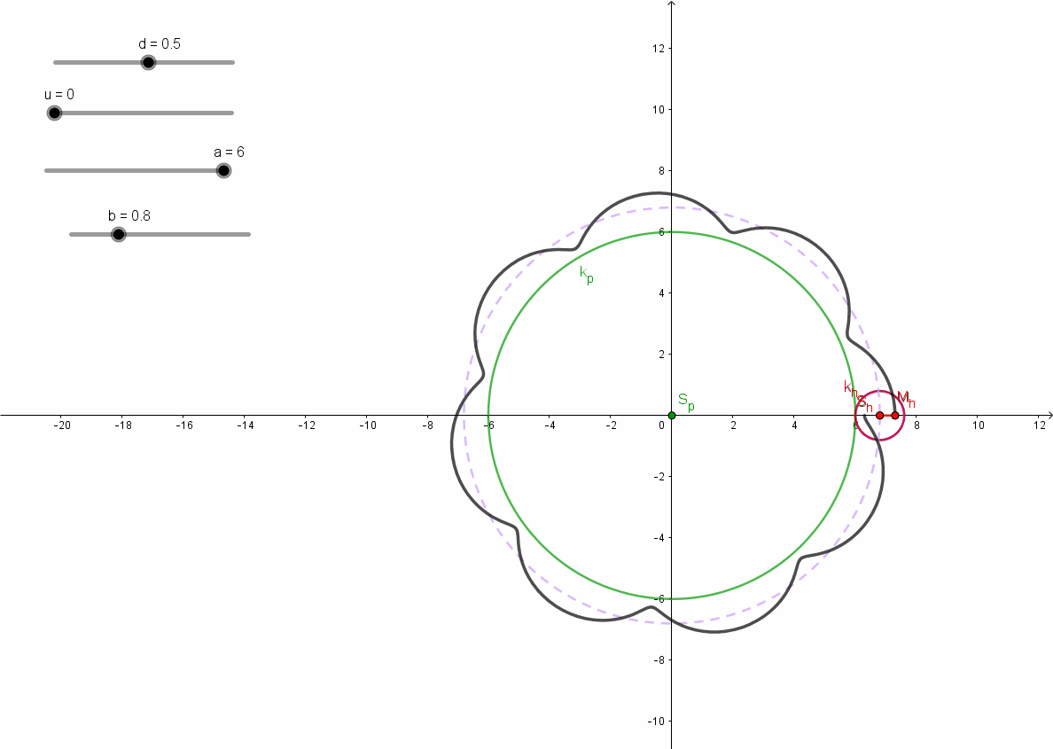
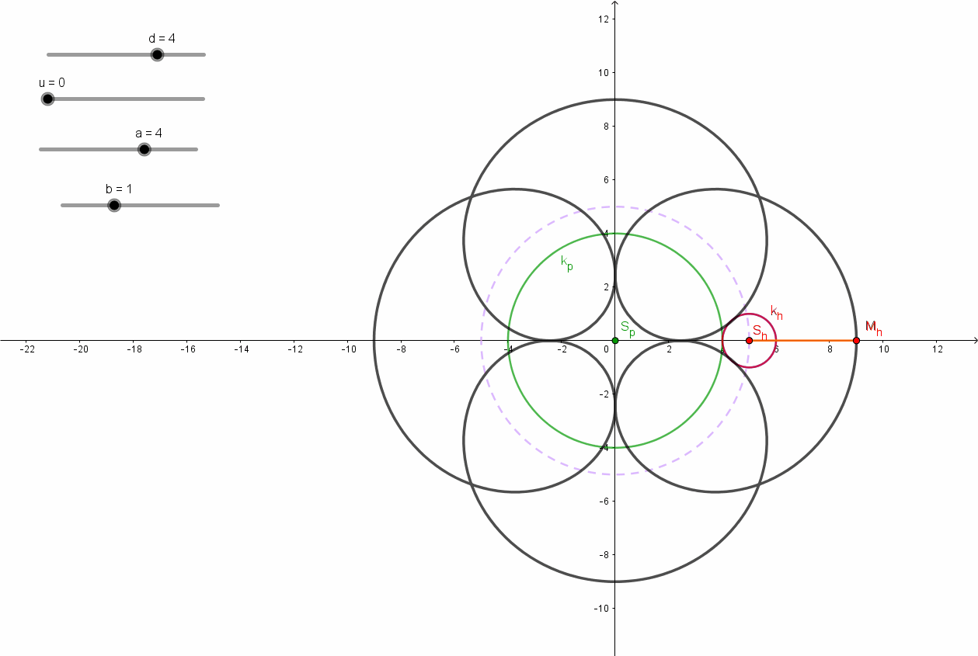
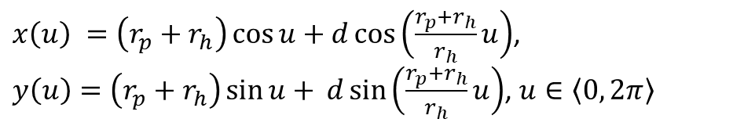
$x\left(u\right) =\left(r_{p}+r_{h}\right)\cos{u+d\cos\left(\frac{r_{p}+r_{h}}{r_{h}}u\right)}$,
$y\left(u\right)=\left(r_{p}+r_{h}\right)\sin{u+} d\sin\left(\frac{r_{p}+r_{h}}{r_{h}}u\right)$, $u∈\left\langle 0, 2π\right\rangle$
Epicycloid
curtate open prolate closed

Slide 5
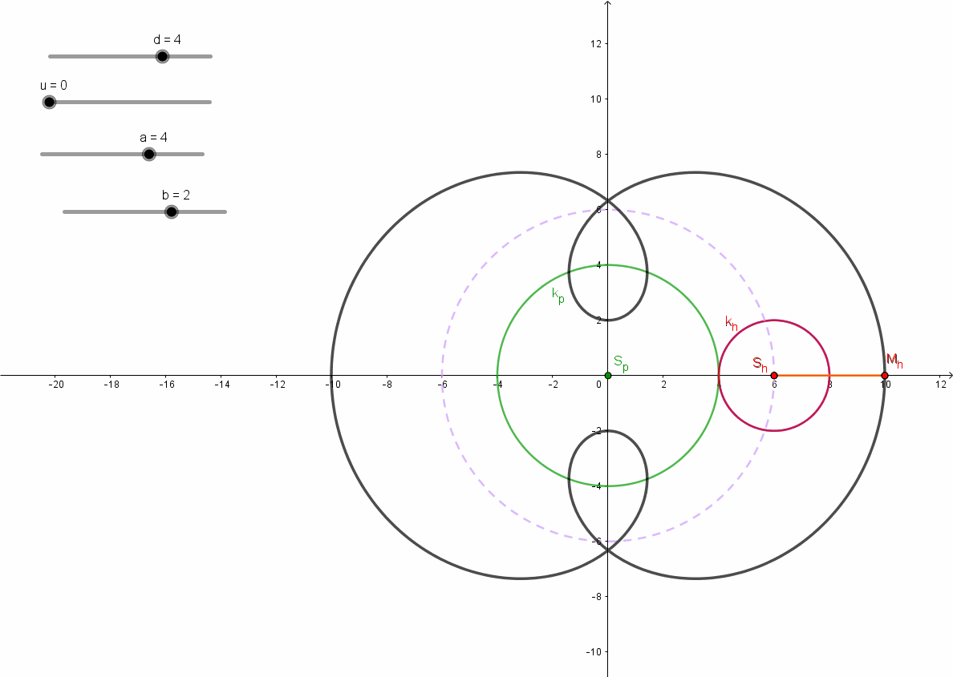
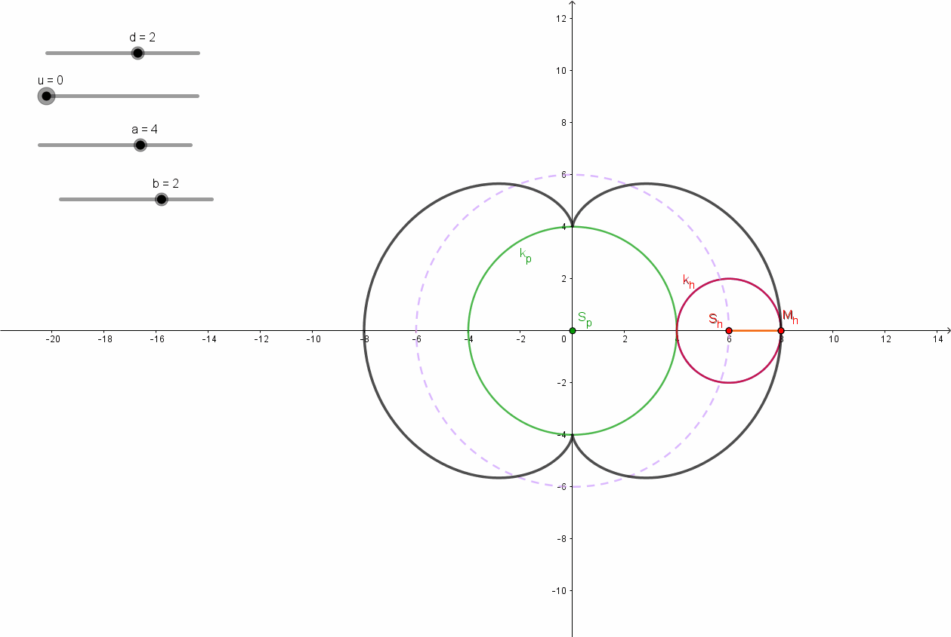
Epicycloid – r_{p} : r_{h} = 2 : 1
Nefroid prolate Nefroid simple

Slide 6
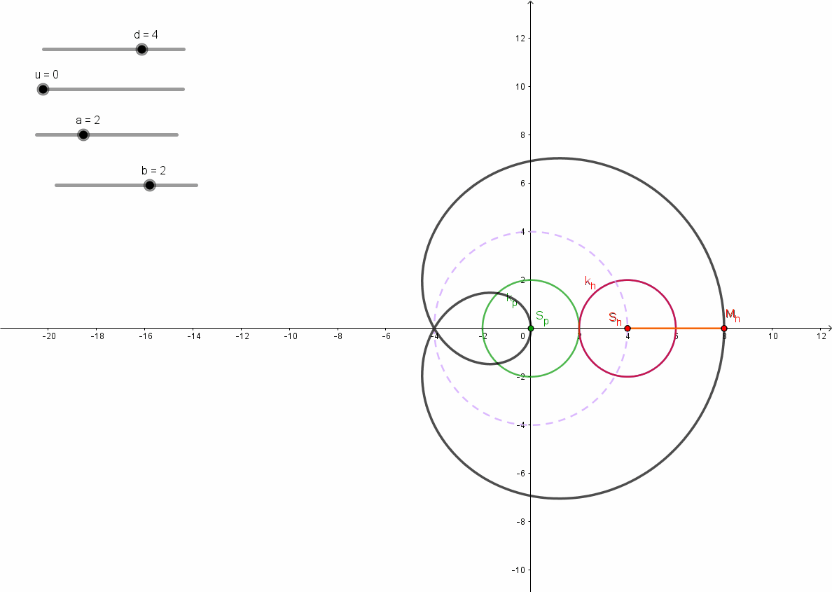
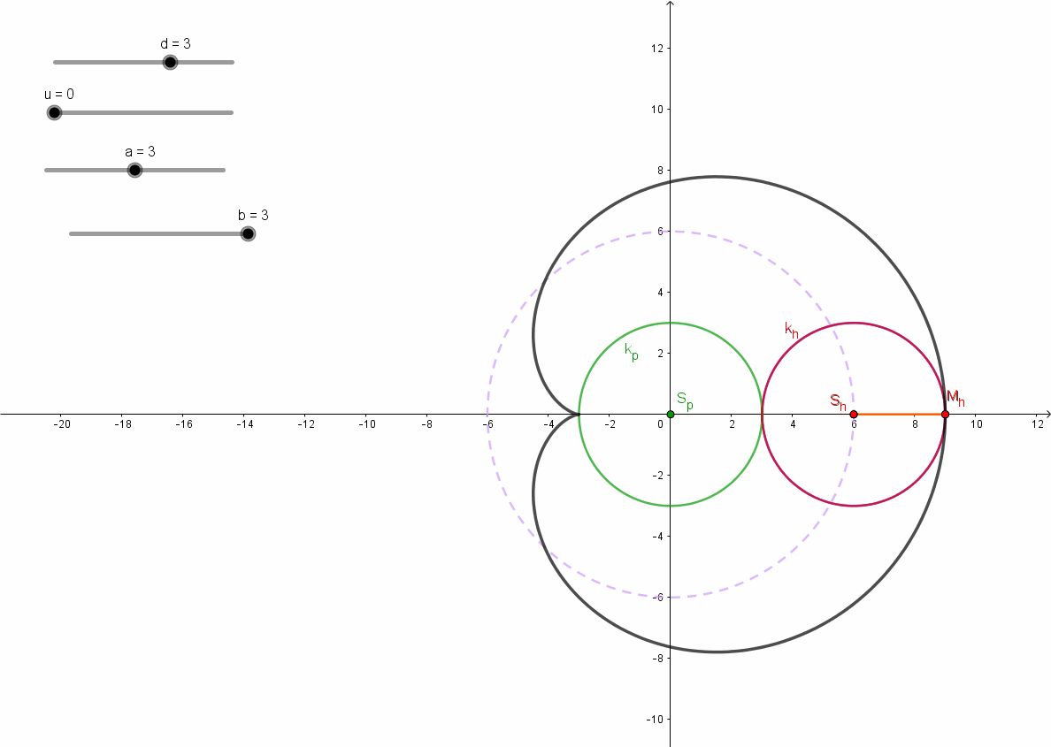
Epicycloid – r_{p} : r_{h} = 1 : 1
Cardioid (simple) Limaçon of Pascal (prolate)

Slide 7
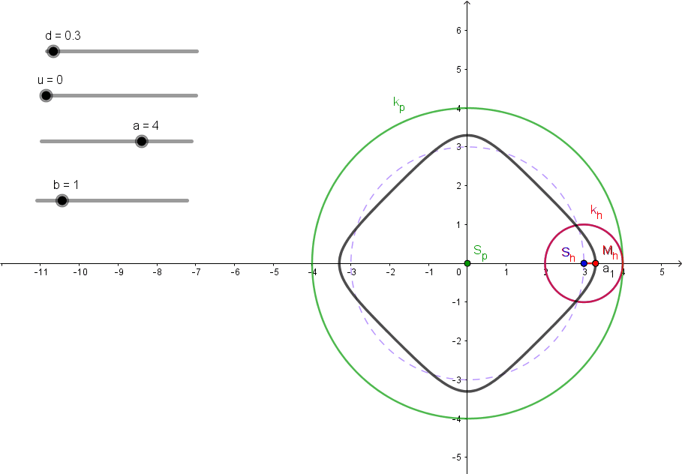
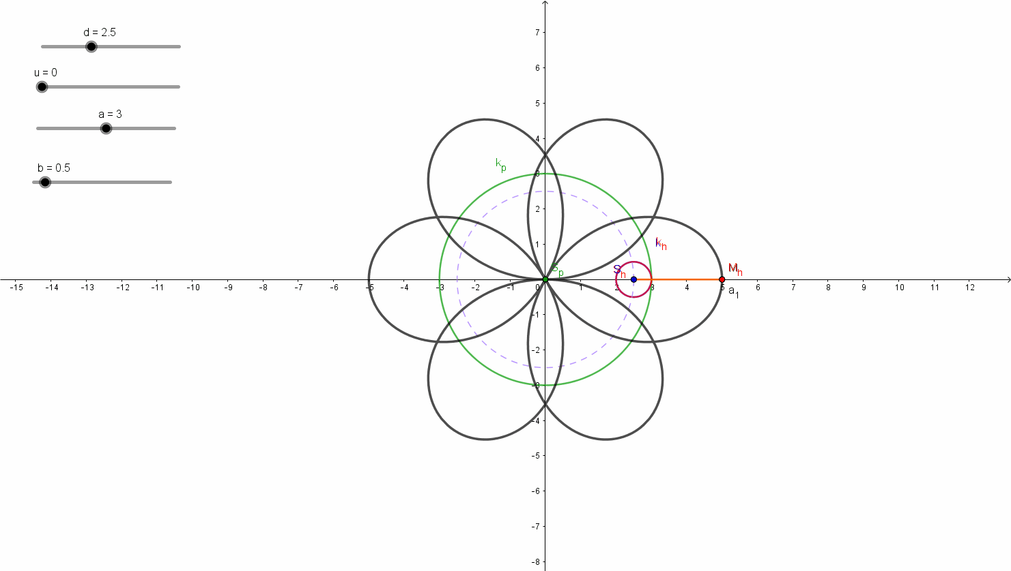
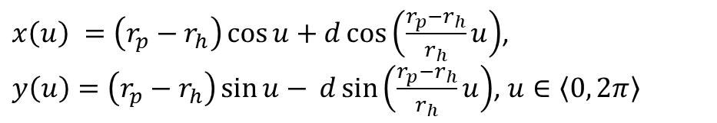
$x\left(u\right) =\left(r_{p}−r_{h}\right)\cos{u+d\cos\left(\frac{r_{p}−r_{h}}{r_{h}}u\right)}$,
$y\left(u\right)=\left(r_{p}−r_{h}\right)\sin{u−} d\sin\left(\frac{r_{p}−r_{h}}{r_{h}}u\right)$, $u∈\left\langle 0, 2π\right\rangle$
Hypocycloid
curtate prolate

Slide 8
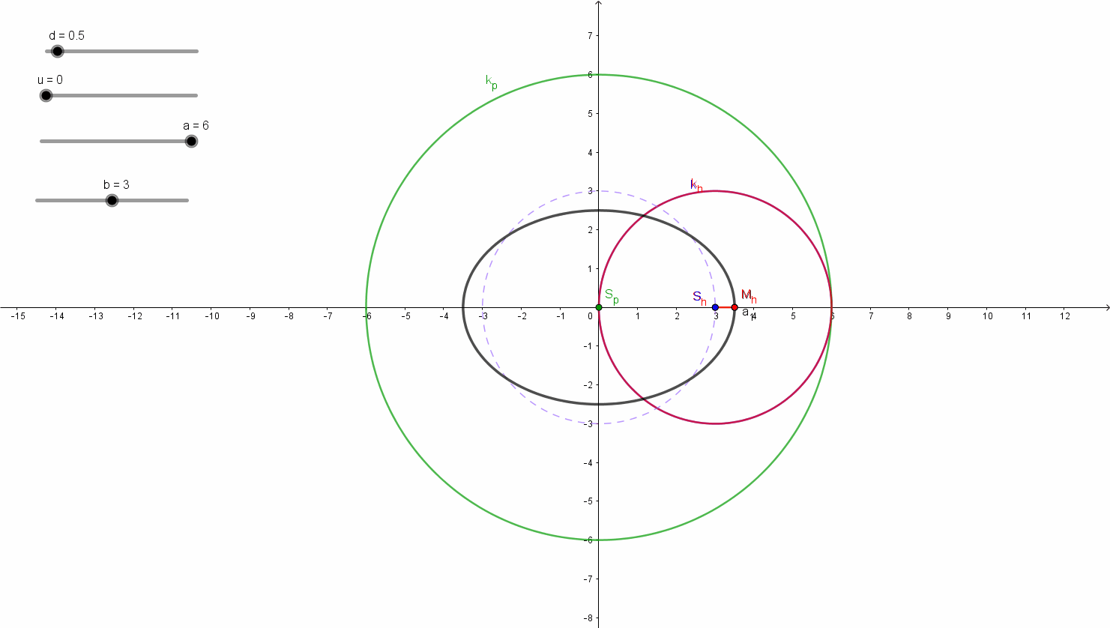
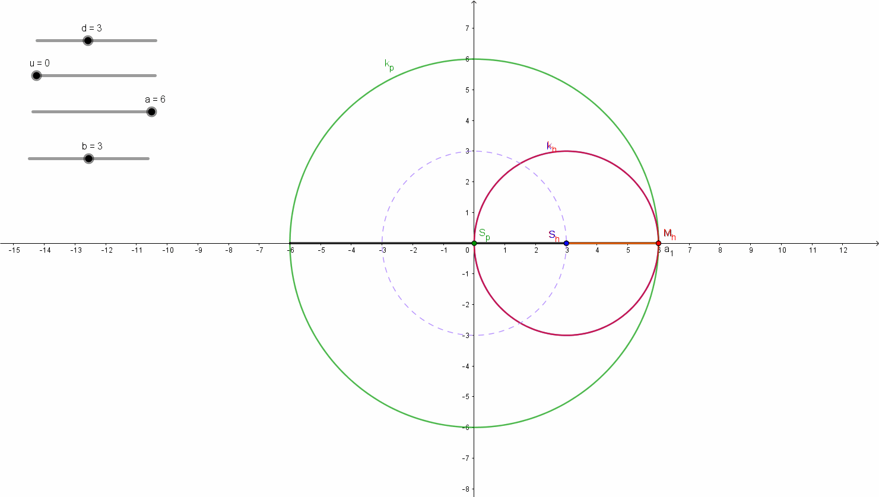
Hypocycloid – r_{p} : r_{h} = 2 : 1
curtate – elliptic motion simple – line segment

Slide 9
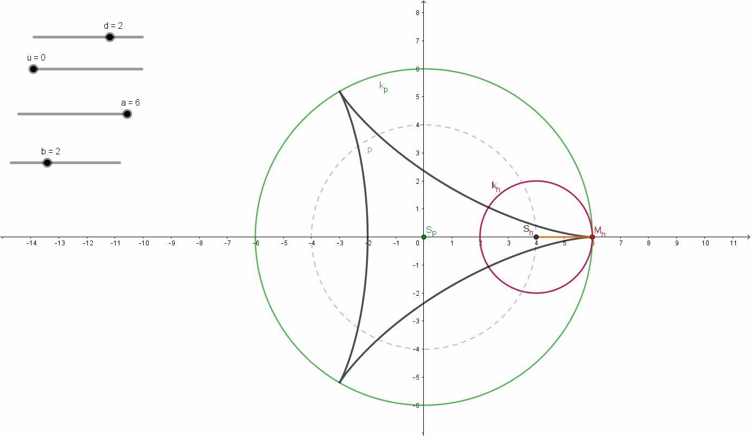
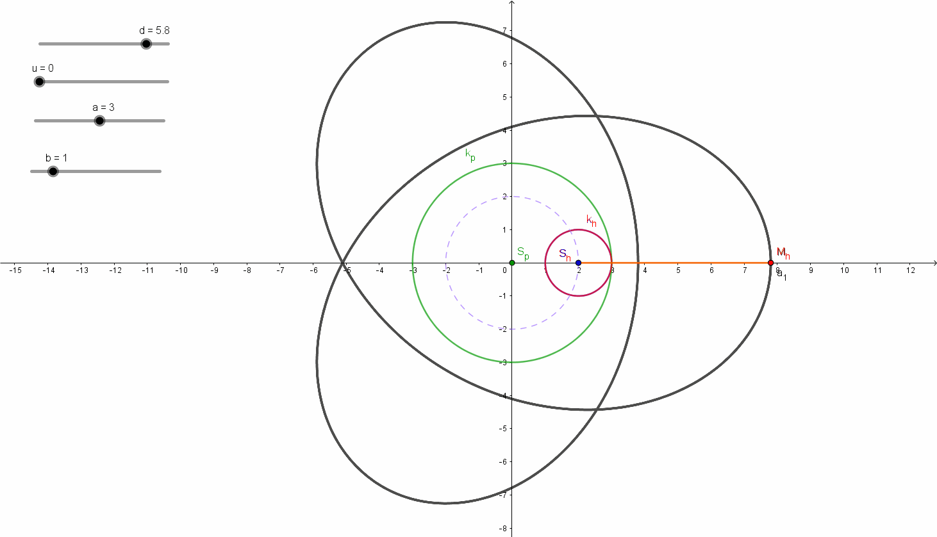
Steiner hypocycloid – r_{p} : r_{h} = 3 : 1
simple prolate

Slide 10
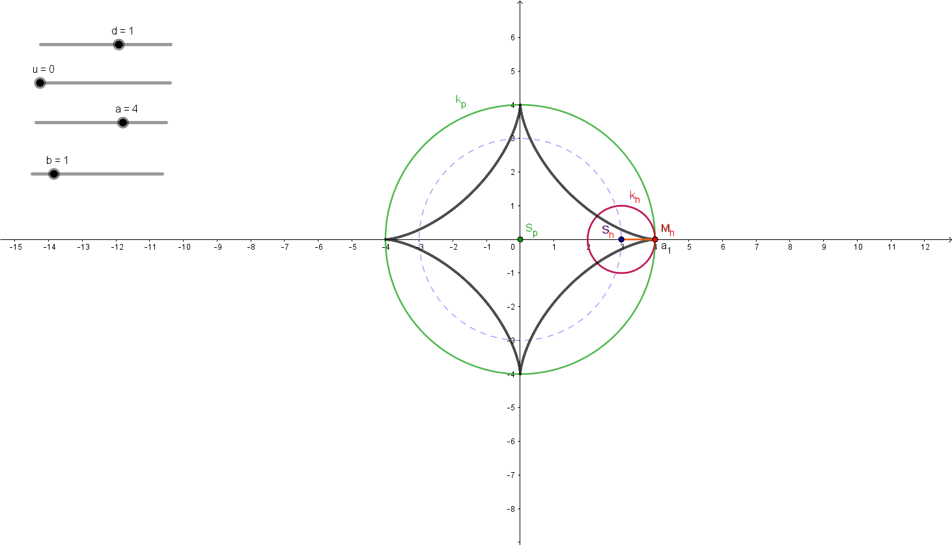
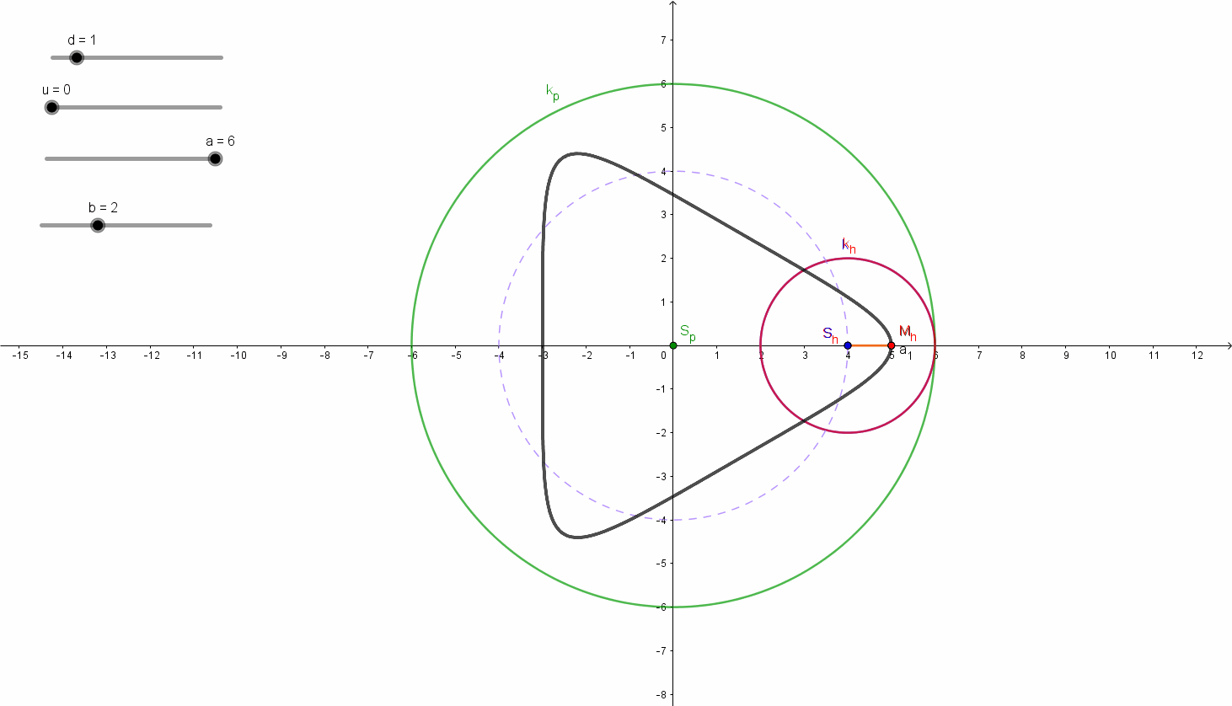
Steiner hypocycloid curtate Asteroid (simple hypocycloid)
r_{p} : r_{h} = 3 : 1 r_{p} : r_{h} = 4 : 1

Slide 11
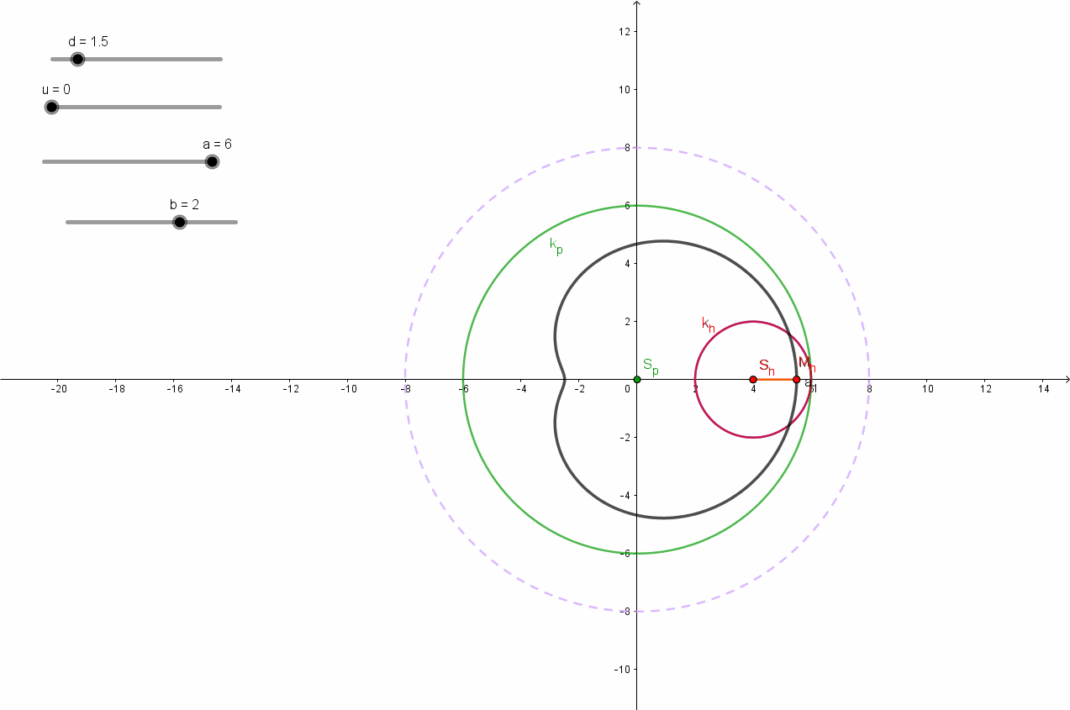
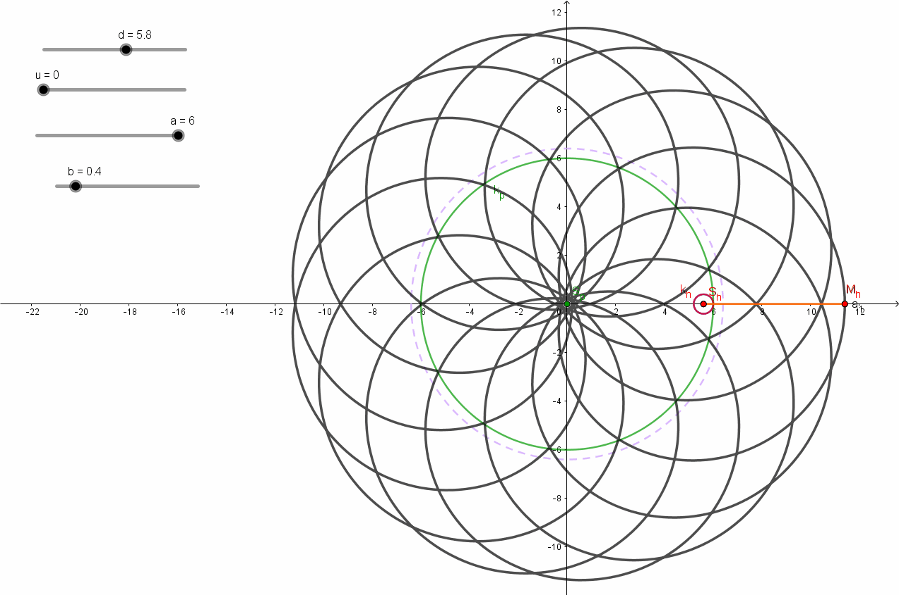
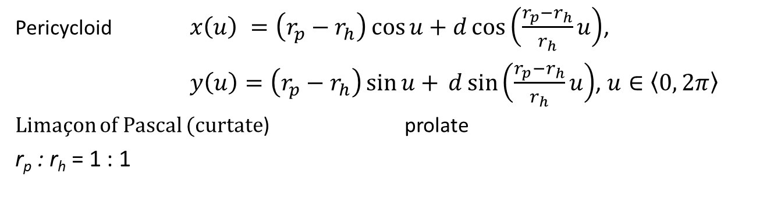
Pericycloid $x\left(u\right) =\left(r_{p}−r_{h}\right)\cos{u+d\cos\left(\frac{r_{p}−r_{h}}{r_{h}}u\right)}$,
$y\left(u\right)=\left(r_{p}−r_{h}\right)\sin{u+} d\sin\left(\frac{r_{p}−r_{h}}{r_{h}}u\right)$, $u∈\left\langle 0, 2π\right\rangle$
Limaçon of Pascal (curtate) prolate
r_{p} : r_{h} = 1 : 1

Slide 12
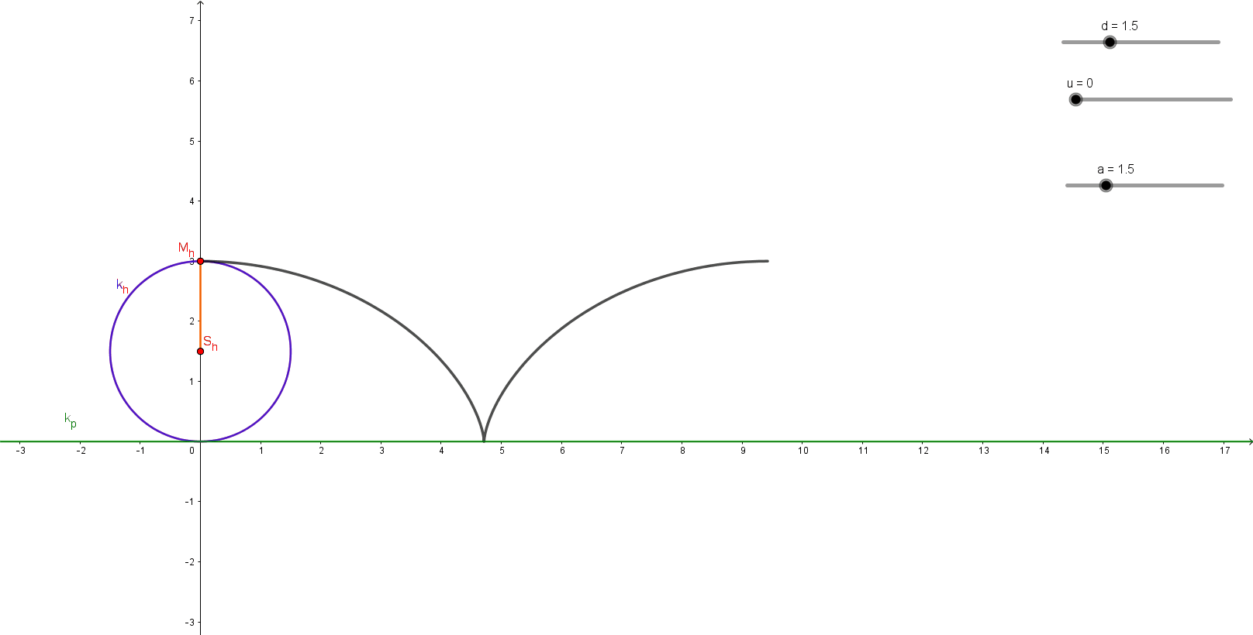
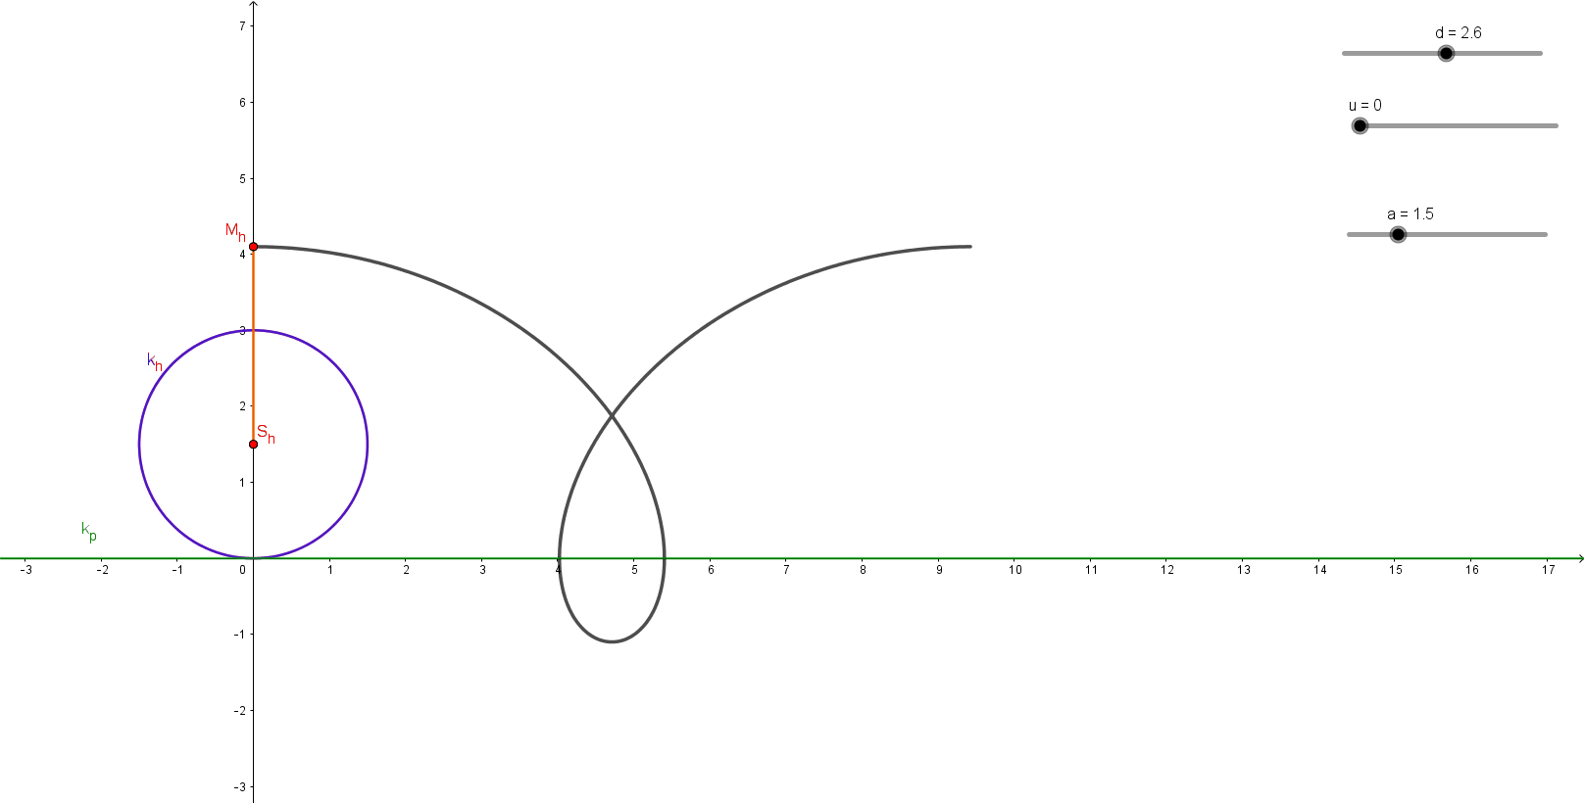

Orthocycloid $u∈\left\langle 0, 2π\right\rangle$
$$x\left(u\right)=d\sin{u+r_{h}u}$$
$$y\left(u\right)=d\cos{u+}r_{h}$$
simple prolate

Slide 13
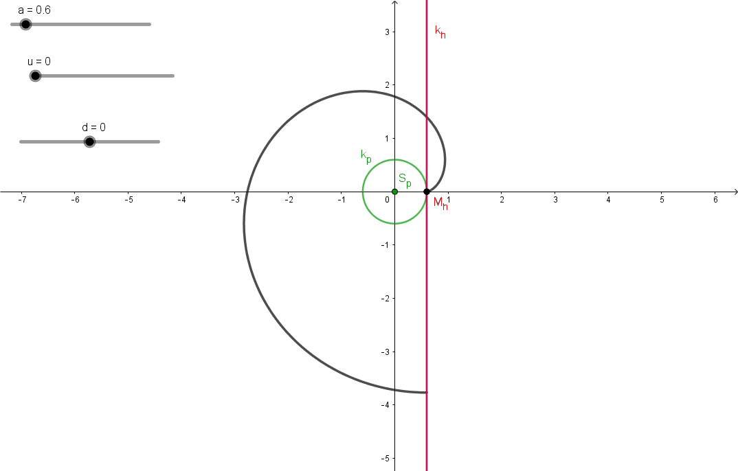
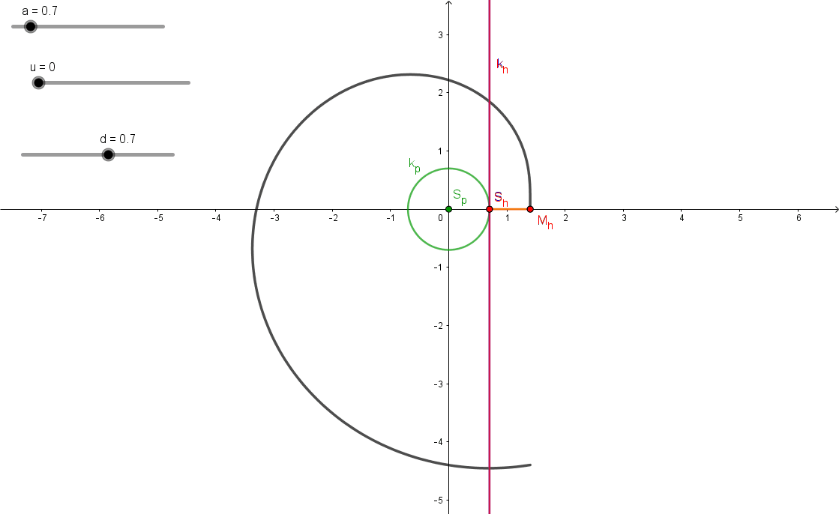

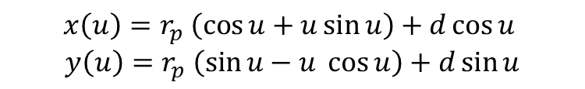
Involute of a circle $u∈\left\langle 0, 2π\right\rangle$
$$x\left(u\right)=r_{p} \left(\cos{u+u\sin{u}}\right)+d\cos{u}$$
$$y\left(u\right)=r_{p} \left(\sin{u−u{\cos{u}}}\right)+d\sin{u}$$
Simple Archimedean spiral – r_{p} = d

